Slide 1
Structured Data Type - Array
Data types examined so far are atomic:
  int, long
  float, double
  char
Called “simple” data types because vars hold a single value
If limited to “simple” data types, many programming applications are tedious
Solution: use structured data types - types that represent more than one piece of data

Slide 2
Sample Problem
Problem: track sales totals for 10 people
Daily data:
  Employee # Sale
  ---------- ----
  3 9.99
  7 16.29
  9 7.99
  3 2.59
  .
  .
  .
  7 49.00

Slide 3
Data Structure
A Data Structure is a grouping of data items in memory under one name
When data items same type, can use Array
Using an array, we can set aside a block of memory giving the block a name:
  Sales vs. S0
  S1
  …
  S9

Slide 4
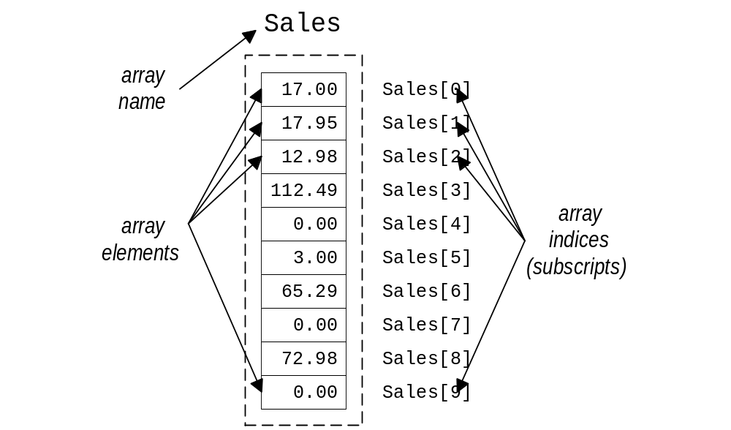
Parts of an Array

Slide 5
Declaring a 1D Array
Syntax: Type Name[IntegerLiteral]
  Type can be any type we have used so far
  Name is a variable name used for the whole array
  Integer literal in between the square brackets ([]) gives the size of the array (number of sub-parts)
  Size must be a constant value (no variable size)
  Parts of the array are numbered starting from 0
  1-Dimensional (1D) because it has one index
Example:
  float Sales[10];
  /* float array with 10 parts numbered 0 to 9 */

Slide 6
Array Indices
The array indices are similar to the subscripts used in matrix notation:
  Sales[0] is C notation for Sales
  Sales[1] is C notation for Sales
  Sales[2] is C notation for Sales
The index is used to refer to a part of array
Note, C does not check your index (leading to index-out-of-range errors)
0
1
2

Slide 7
Accessing Array Elements
Requires
  array name,
  subscript labeling individual element
Syntax: name[subscript]
Example
  Sales[5] refers to the sales totals for employee 5
  Sales[5] can be treated like any float variable:
    Sales[5] = 123.45;
    printf(“Sales for employee 5: $%7.2f\n”,Sales[5]);

Slide 8
Array Initialization
Arrays may be initialized, but we need to give a list of values
Syntax:
  Type Name[Size] =
  { value0, value1, value2, …, valueSize-1 };
  value0 initializes Name[0], value1 initializes Name[1], etc.
  values must be of appropriate type (though automatic casting will occur)

Slide 9
Array Initialization
Example:
  int NumDays[12] = { 31, 28, 31, 30, 31, 30, 31, 31, 30, 31, 30, 31 }; /* Jan is 0, Feb is 1, etc. */
  int NumDays[13] = { 0, 31, 28, 31, 30, 31, 30, 31, 31, 30, 31, 30, 31 }; /* Jan is 1, Feb is 2, */
Note:
  if too few values provided, remaining array members not initialized
  if too many values provided, a syntax error or warning may occur (extra values ignored)

Slide 10
Sales Data as an Array
Recall data:
  Employee # Sale
  ---------- ----
  3 9.99
  7 16.29
  9 7.99
  3 2.59
  .
  .
  .
  7 49.00
Idea: declare Sales as array, update array items

Slide 11
Using Array Elements
Array elements can be used like any variable
  read into:
    printf(“Sales for employee 3: “);
    scanf(“%f”,&(Sales[3]));
  printed:
    printf(“Sales for employee 3 $%7.2f\n”,Sales[3]);
  used in other expressions:
    Total = Sales[0] + Sales[1] + Sales[2] + …;

Slide 12
Arrays and Loops
Problem: initialize Sales with zeros
  Sales[0] = 0.0;
  Sales[1] = 0.0;
  …
  Sales[9] = 0.0;
Should be done with a loop:
  for (I = 0; I < 10; I++)
  Sales[I] = 0.0;

Slide 13
Processing All Elements of Array
Process all elements of array A using for:
  /* Setup steps */
  for (I = 0; I < ArraySize; I++)
  process A[I]
  /* Clean up steps */
Notes
  I initialized to 0
  Terminate when I reaches ArraySize

Slide 14
Array Programming Style
Define constant for highest array subscript:
  #define MAXEMPS 10
Use constant in array declaration:
  float Sales[MAXEMPS];
Use constant in loops:
  for (I = 0; I < MAXEMPS; I++)
  fscanf(istream,”%f”,&(Sales[I]));
If MAXEMPS changes, only need to change one location

Slide 15
Summing Elements in an Array
Sales
117.00 Sales[0]
129.95 Sales[1]
276.22 Sales[2]
…
197.81 Sales[9]
total = 0.0;
for (I = 0; I < MAXEMPS; I++)
total += Sales[I];
I Total
0.00
0 117.00 (Emp 0 sales)
1 246.95 (0 + 1 sales)
2 523.17 (0 + 1 + 2 s)
…
9 1943.89 (All emps)

Slide 16
Maximum Element of an Array
Sales
117.00 Sales[0]
129.95 Sales[1]
276.22 Sales[2]
…
197.81 Sales[9]
maxS = Sales[0];
for (I = 1; I < MAXEMPS; I++)
if (Sales[I] > maxS)
maxS = Sales[I];
/* Note I starts at 1 */
I maxS
117.00
1 129.95 (Max of 0,1)
2 276.22 (Max of 0,1,2)
…
9 276.22 (Max of all)

Slide 17
Printing Elements of an Array
Sales
117.00 Sales[0]
129.95 Sales[1]
276.22 Sales[2]
…
197.81 Sales[9]
printf(“Emp Num Sales\n”);
printf(“------- -----\n”);
for (I = 0; I < MAXEMPS; I++)
printf(“%4d%13.2f\n”, I, Sales[I]);
Output:
Emp Num Sales
------- ------
0 117.00
1 129.95
2 276.22
…
9 197.81

Slide 18
Passing an Element of an Array
Each element of array may be passed as parameter as if it were variable of base type of array (type array is made of)
When passing array element as reference parameter put & in front of array element reference ([] has higher precedence)
  does not hurt to put parentheses around array reference though
  example &(Sales[3])

Slide 19
Passing Array Element Examples
Passing by value:
void printEmp(int eNum, float eSales) {
printf(“%4d%13.2f\n”, eNum, eSales);
}
in main:
printf(“Emp Num Sales\n”);
printf(“------- -----\n”);
for (I = 0; I < MAXEMPS; I++)
printEmp(I,Sales[I]);
Passing by reference:
void updateSales(float *eSales, float newS) {
*eSales = *eSales + newS;
}
in main:
while (fscanf(sdata,”%d%f”, &numE,&amtS) == 2)
updateSales(
&(Sales[numE]), amtS);

Slide 20
Passing Whole Array
When we pass an entire array we always pass the address of the array
  syntax of parameter in function header:
    BaseType NameforArray[]
    note, no value between [] - compiler figures out size from argument in function call
  in function call we simply give the name of the array to be passed
  since address of array is passed, changes to elements in the array affect the array passed as argument (no copy of array is made)

Slide 21
Passing Whole Array Example
float calcSalesTotal(float S[]) {
int I;
float total = 0.0;
for (I = 0; I < MAXEMPS; I++)
total += S[I];
return total;
}
in main:
printf(“Total sales is %7.2f\n”,
calcSalesTotal(Sales));

Slide 22
Size of an Array
Sometimes we know we need an array, but not how big the array is going to be
One solution:
  allocate a very large array
  integer to indicate num elements of array in use
  loops use num elements when processing
Example:
    float Sales[MAXEMPS];
    int NumEmps = 0;
  processing:
    for (I = 0; I < NumEmps; I++)
    process Sales[I];

Slide 23
Sorting Arrays
One common task is to sort data
Examples:
  Phone books (by name)
  Checking account statement (by check #)
  Dictionaries (by word)
  NBA scoring leaders (by points)
  NBA team defense (by points)

